Slide 1
Tampa Bay Neighborhood Analysis
IBM Data Science – Capstone Project

Slide 2
Introduction
Tampa bay is known for various things like vacation spots, beautiful beaches, water sports, theme parks, lively entertainment areas like Sundial, AMCs etc. For people who are searching and analyzing for short time trips, relocate to Tampa bay from other locations this project can be a starting point to identify the county/city which will be suitable for their own needs like Restaurants, Movie theaters, clubs, Gym, Parks, Hospitals etc.
Planning for trips/relocating to a new Location needs lot of analysis like
Neighborhoods
Amenties
Entertainment
Vacation spots etc

Slide 3
Objective
This project will provide a brief idea about few counties and located in Tampa bay like Pasco, Hillsborough, and Pinellas. This looks at neighborhoods and locations nearby and helps anyone to choose the best place to live within any given city based on the preferences satisfied.
Using segmentation and clustering based on the common places retrieved from Foursquare Determine
Similarity or dissimilarity of areas between counties
Classification of areas located around the Neighborhood.

Slide 4
Data
The data set includes the coordinates of the cities/neighborhoods in the USA in JSON format with the county, latitude, longitude,State,Timezone etc.
With the available data the project is designed to use location coordinates and tag each data point into a neighborhood in few Counties in Florida -Tampa bay - Pasco, Hillsborough and Pinellas County. The algorithm used is k-means clustering. The main idea is to determine neighborhood with venues clustered around each other so that one can make a decision on the right neighborhood to chose based on the person's requirements
Data set was downloaded from simplemaps as json data into
https://raw.githubusercontent.com/natarajarumuga/Capstone/master/us_cities.json

Slide 5
Methods
Data Analysis :
Load the data from json file, read into pandas dataframe to perform the analysis on the data by counties using Foursquare. Analysis was performed using the following
Segment the Data into Location from Tampa bay Counties – Pinellas, Hillsborough and Pasco.
Filter missing values and columns
Using K-means, Cluster the data into multiple levels for comparison.
Segmenting and Slicing:
Based on the dataset values, segment the data into Neighborhood, County, State, City Name, Latitude, Longitude, and Density for Pasco, Hillsborough and Pinellas County. Using Foursquare API, collect the venues for each county and city Name. There are some challenges with Foursquare with missing data for some of these locations and K-means process needs to be carefully analyzed to filter those data which will not be providing any value for comparison and proceeding with Analysis.
Slicing of data was performed to identify only those columns required for our analysis and filter other columns like Time Zone, State name, Country etc which are not considered or relevant for this analysis.

Slide 6
Methods
Neighborhood Analysis
Using Folium package, data for the counties – Pinellas, Pasco and Hillsborough were plotted with the locations collected from Foursquare API and coordinates from the data. For this analysis we have considered top 100 locations within a limit of 500m radius. One hot encoding was performed on the locations to get a comparable value for analysis like 0 and 1. Results were grouped by neighborhood locations by mean of the frequency of the occurrence for each category.
Clustering
K-Means clustering was used to cluster the locations in the neighborhood for each County. We have used a predefined number of clusters for each county as part of the dataset. On the basis of K –means model, the following is performed
Define Cluster center as arithmetic mean of the all the points to the Cluster
Each point is closer to its own cluster.
To visualize the data better, Data was sliced for each county by neighborhood and locations around the neighborhood within the county.

Slide 7
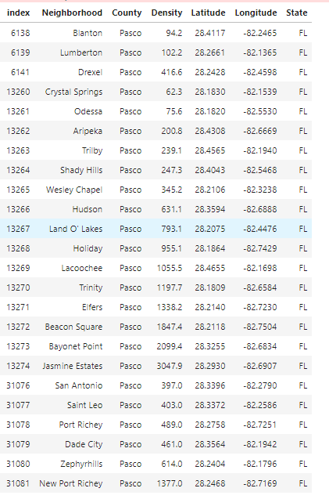
Methods
Sliced Data –Pasco County

Slide 8
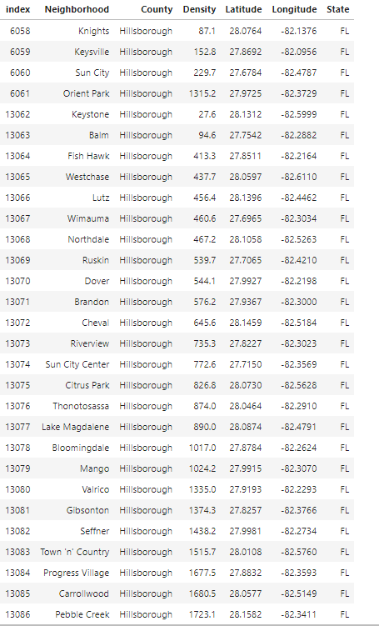
Methods
Sliced Data –Hillsborough County

Slide 9
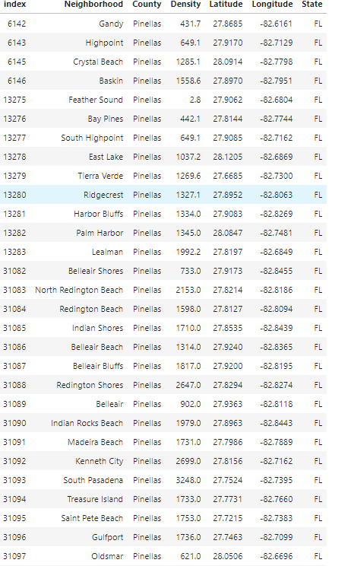
Methods
Sliced Data –Pinellas County

Slide 10
Methods
Neighborhoods near Tampa Bay Counties
Using Foursquare API
Collect data for each Neighborhood for each County
Gather data for Top 10 Most Common Venues for Each County
Cluster the data based on the Venues information collected using Foursquare API
Using Folium Package
Plot the data on the Map based on Spatial Location Coordinates
Using One Hot Encoding
- Using One hot Encoding, convert the venues into Categories grouped by each neighborhood.
- This is required to Perform cluster analysis for the Neighborhood venues.

Slide 11
Methods
K-means Algorithm
K-means algorithm will be applied to the data set after One hot encoding.
This algorithm will be applied to the following counties in Tampa Bay for our analysis
Pasco
Pinellas
Hillsborough

Slide 12
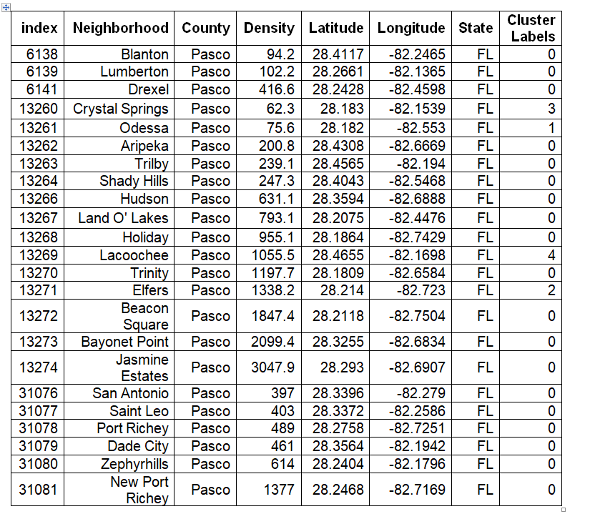
Cluster Results – Pasco County

Slide 13
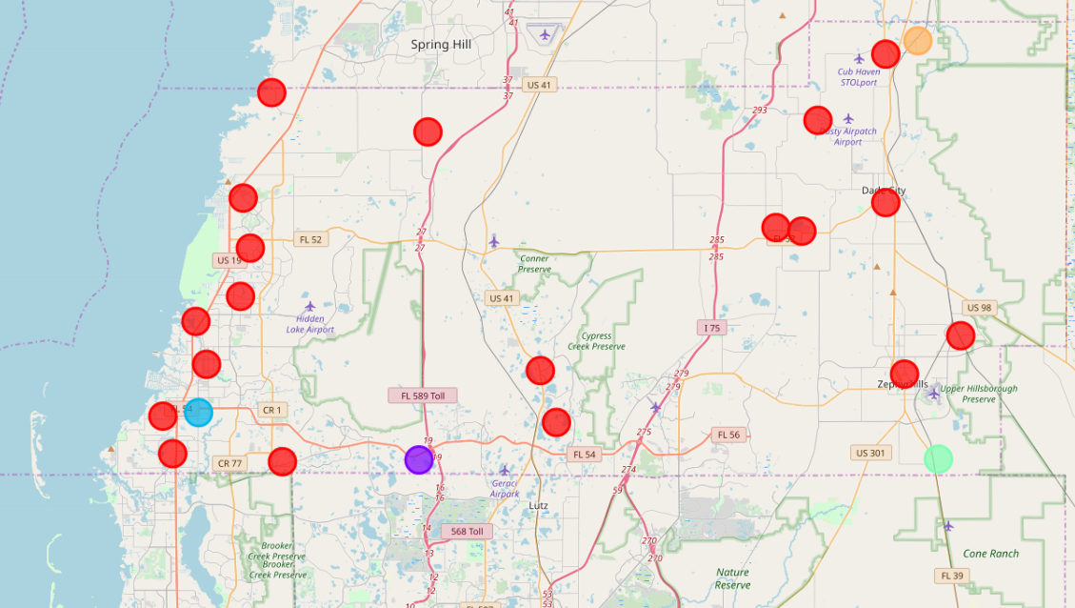
Cluster Results – Pasco County
Cluster Map -Pasco

Slide 14
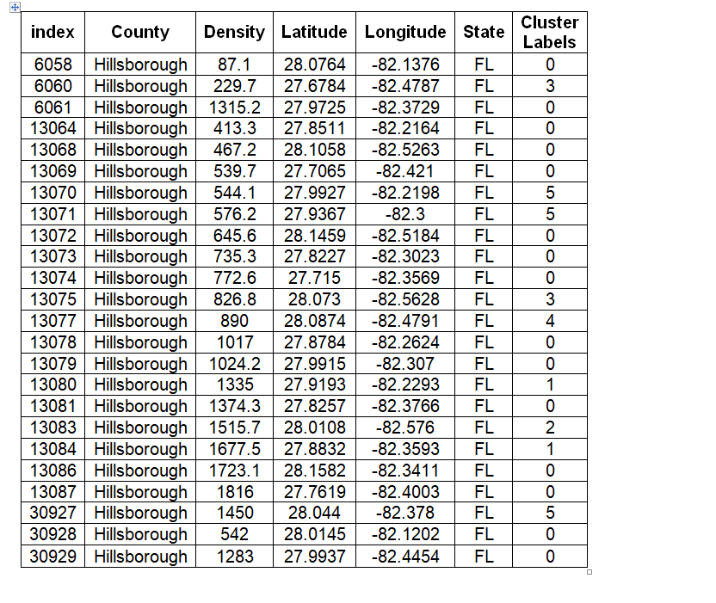
Cluster Results – Hillsborough County

Slide 15
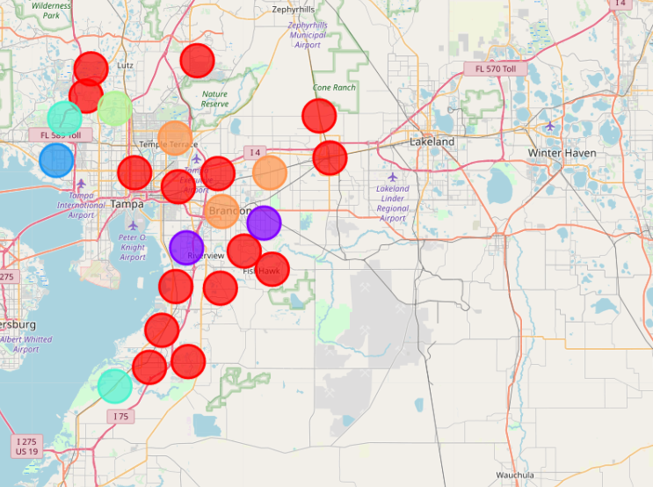
Cluster Results – Hillsborough County
Cluster Map - Hillsborough

Slide 16
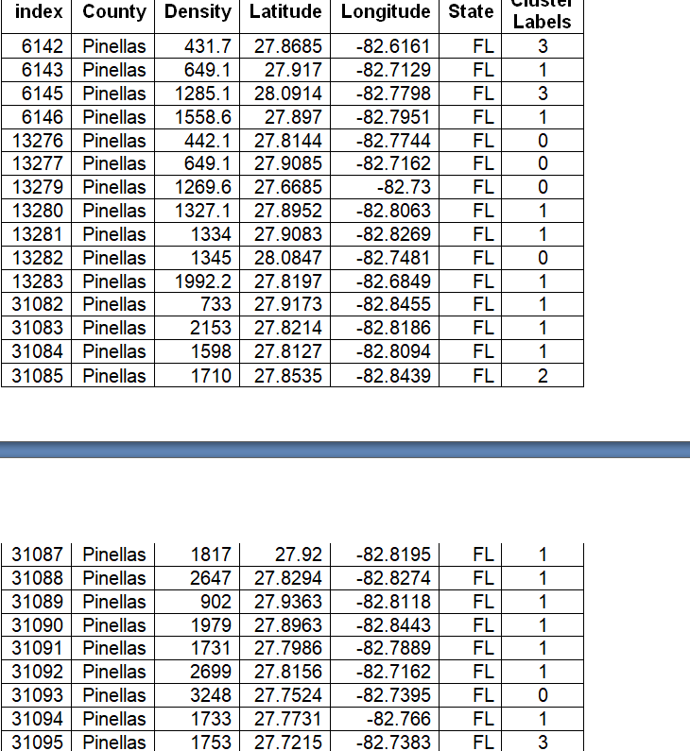
Cluster Results – Pinellas County

Slide 17
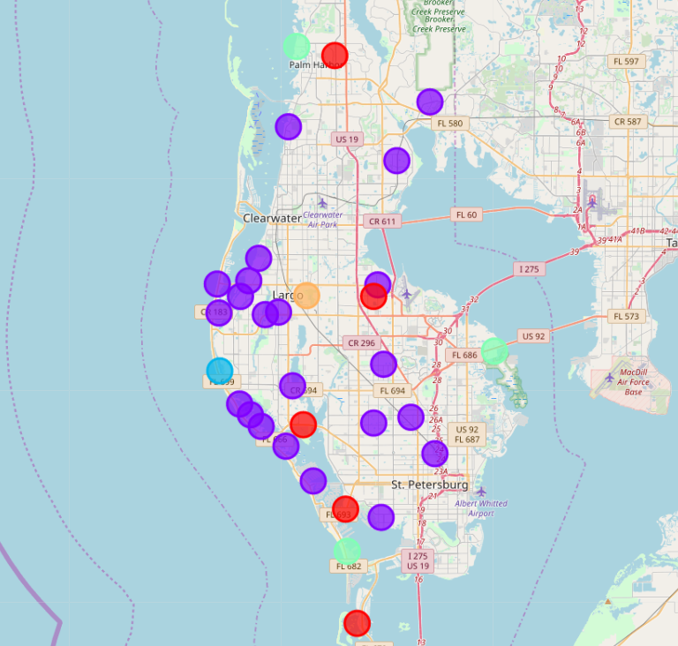
Cluster Results – Pinellas County
Cluster Map - Pinellas

Slide 18
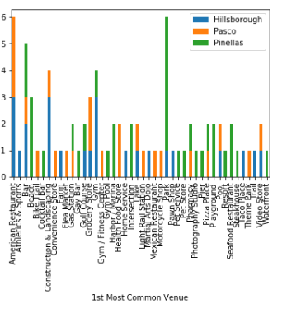
Cluster results
Combine all the counties data into one Data frame .
Plot the Most common venues for all counties.

Slide 19
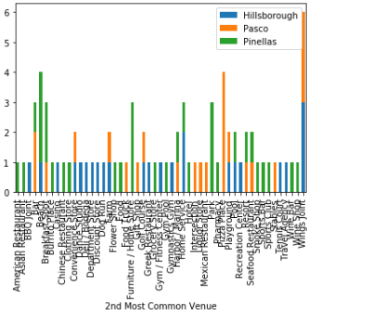
Cluster Results

Slide 20
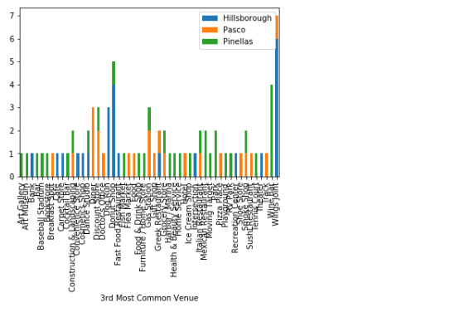
Cluster Results

Slide 21
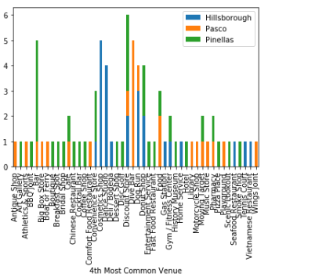
Cluster Results

Slide 22
Cluster Result Discussion
Based on the data and the results of the cluster, the neighborhood venues in Red cluster have more venues in Pasco and Hillsborough Counties and Purple cluster in Pinellas. Analyzing the venues, Pasco and Hillsborough County has more similar category of venues as most common ones like Gas Station, Doctor Office, Bar, Gym, Restaurants etc Whereas Pinellas County has Beach, Hotels, Resort, Pier as the most common Venus. People, who are searching to move-in or plan trips in Tampa bay, can select any of these neighborhoods based on the preference. For eg: People who likes to live near ocean, visit beaches frequently can choose Pinellas county where as people who likes amenities like Gym, Gas station, Restaurants can choose Pasco/Hillsborough county.
Similarly for people visiting Tampa bay can decide the place in Pinellas County as this county has the Hotel, Resort and Beach as most common Venues.

Slide 23
Conclusion
This project is designed to provide an insight into locations near Tampa bay for help people look and decide the best place to choose to rent, live, visit. Using Information available for public datasets for free I chose three different counties in Tampa bay to analyze the neighborhoods based on the spatial distribution of Venues.
This analysis was performed using Python libraries like Folium, matplotlib for visualizing the data, Foursquare API to get the venue information. K-means Algorithm was applied to cluster the data for these neighborhoods.
There were some challenges with missing data for few of the neighborhoods which could have provided additional information and affected the results. Also this project has scope to improve more to compare different counties/cities/States in United States with this data.

